Slide 1
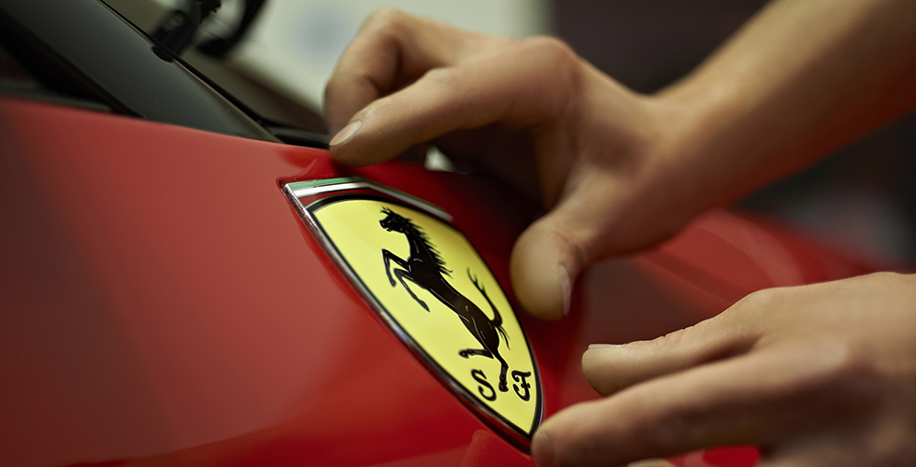
Ferrari Company Presentation & «F-Factor: The Ferrari Case Study»
Ferrari is glad to announce the dedicated presentation & case study in collaboration with University of Federico II - Naples.
We look forward to meet best Engineering Students - 2° Year - Master’s Degree specializations - and those engineers who have graduated in the past the last 12 months to now.
This is an exceptional opportunity to get to know more about the company itself, engineering testimonials (ex UniNa students) and career opportunities.
June 24th
Aula Edoardo Massimilla
Piazzale Tecchio 80
80125 Napoli
How to apply?
All Engineering students are welcome to join the Company Presentation.
If you want to apply for the F-Factor: The Ferrari Case Study, please fill in the format below and send it to recruitment@ferrari.com specifying: “Ferrari ONE-OFF - UNINA” in the subject field.
Deadline: June 19th, 2019
Name:
Surname:
Date of Born:
Course Name:
Final Grade (expected):
Formula Student experience (yes/no):
Date of availability to start an internship (month/year):
The application will be considered only if CV is attached.

